Slide 1
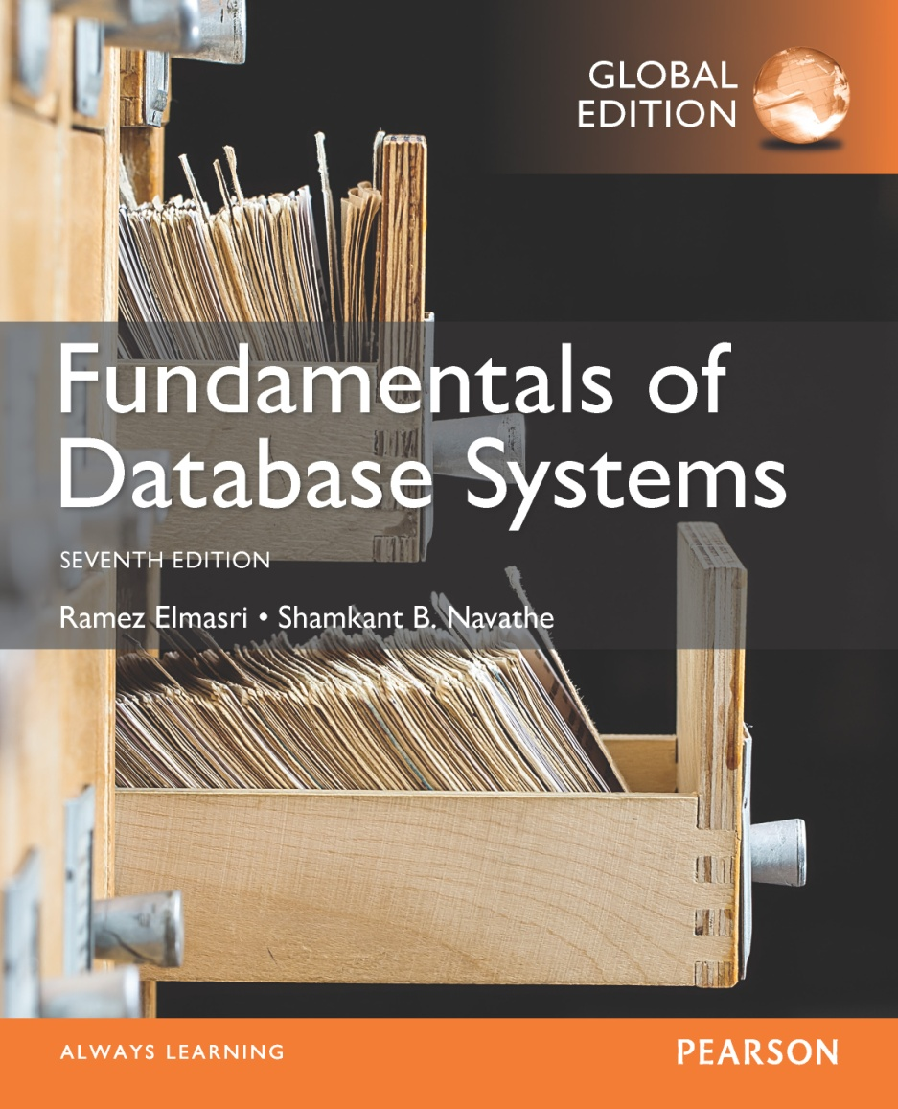

Slide 2
CHAPTER 6
Basic SQL
Slide 6- <number>

Slide 3
Chapter 6 Outline
SQL Data Definition and Data Types
Specifying Constraints in SQL
Basic Retrieval Queries in SQL
INSERT, DELETE, and UPDATE Statements in SQL
Additional Features of SQL
Slide 6- 3

Slide 4
Basic SQL
SQL language
  Considered one of the major reasons for the commercial success of relational databases
SQL
  The origin of SQL is relational predicate calculus called tuple calculus (see Ch.8) which was proposed initially as the language SQUARE.
  SQL Actually comes from the word “SEQUEL” which was the original term used in the paper: “SEQUEL TO SQUARE” by Chamberlin and Boyce. IBM could not copyright that term, so they abbreviated to SQL and copyrighted the term SQL.
  Now popularly known as “Structured Query language”.
  SQL is an informal or practical rendering of the relational data model with syntax
Slide 6- 4

Slide 5
SQL Data Definition, Data Types, Standards
Terminology:
  Table, row, and column used for relational model terms relation, tuple, and attribute
CREATE statement
  Main SQL command for data definition
The language has features for : Data definition, Data Manipulation, Transaction control (Transact-SQL, Ch. 20), Indexing (Ch.17), Security specification (Grant and Revoke- see Ch.30), Active databases (Ch.26), Multi-media (Ch.26), Distributed databases (Ch.23) etc.
Slide 6- 5

Slide 6
SQL Standards
SQL has gone through many standards: starting with SQL-86 or SQL 1.A. SQL-92 is referred to as SQL-2.
Later standards (from SQL-1999) are divided into core specification and specialized extensions. The extensions are implemented for different applications – such as data mining, data warehousing, multimedia etc.
SQL-2006 added XML features (Ch. 13); In 2008 they added Object-oriented features (Ch. 12).
SQL-3 is the current standard which started with SQL-1999. It is not fully implemented in any RDBMS.
Slide 6- 6

Slide 7
Schema and Catalog Concepts in SQL
We cover the basic standard SQL syntax – there are variations in existing RDBMS systems
SQL schema
  Identified by a schema name
  Includes an authorization identifier and descriptors for each element
Schema elements include
  Tables, constraints, views, domains, and other constructs
Each statement in SQL ends with a semicolon
Slide 6- <number>

Slide 8
Schema and Catalog Concepts in SQL (cont’d.)
CREATE SCHEMA statement
  CREATE SCHEMA COMPANY AUTHORIZATION ‘Jsmith’;
Catalog
  Named collection of schemas in an SQL environment
SQL also has the concept of a cluster of catalogs.
Slide 6- 8

Slide 9
The CREATE TABLE Command in SQL
Specifying a new relation
  Provide name of table
  Specify attributes, their types and initial constraints
Can optionally specify schema:
  CREATE TABLE COMPANY.EMPLOYEE ...
  or
  CREATE TABLE EMPLOYEE ...
Slide 6- 9

Slide 10
The CREATE TABLE Command in SQL (cont’d.)
Base tables (base relations)
  Relation and its tuples are actually created and stored as a file by the DBMS
Virtual relations (views)
  Created through the CREATE VIEW statement. Do not correspond to any physical file.
Slide 6- 10

Slide 11
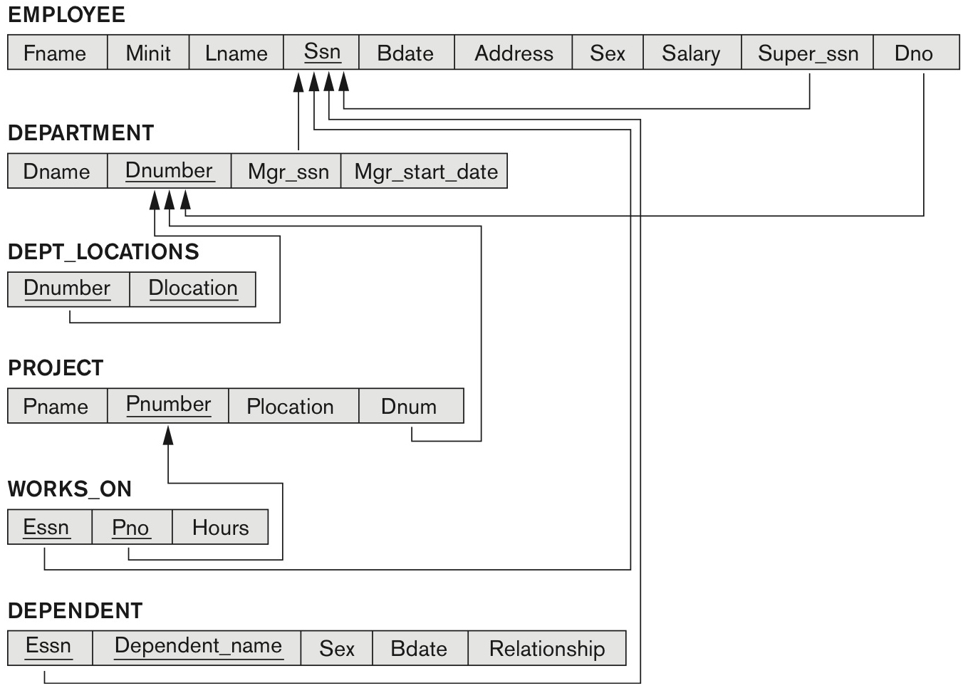
COMPANY relational database schema (Fig. 5.7)
Slide 6- 11

Slide 12
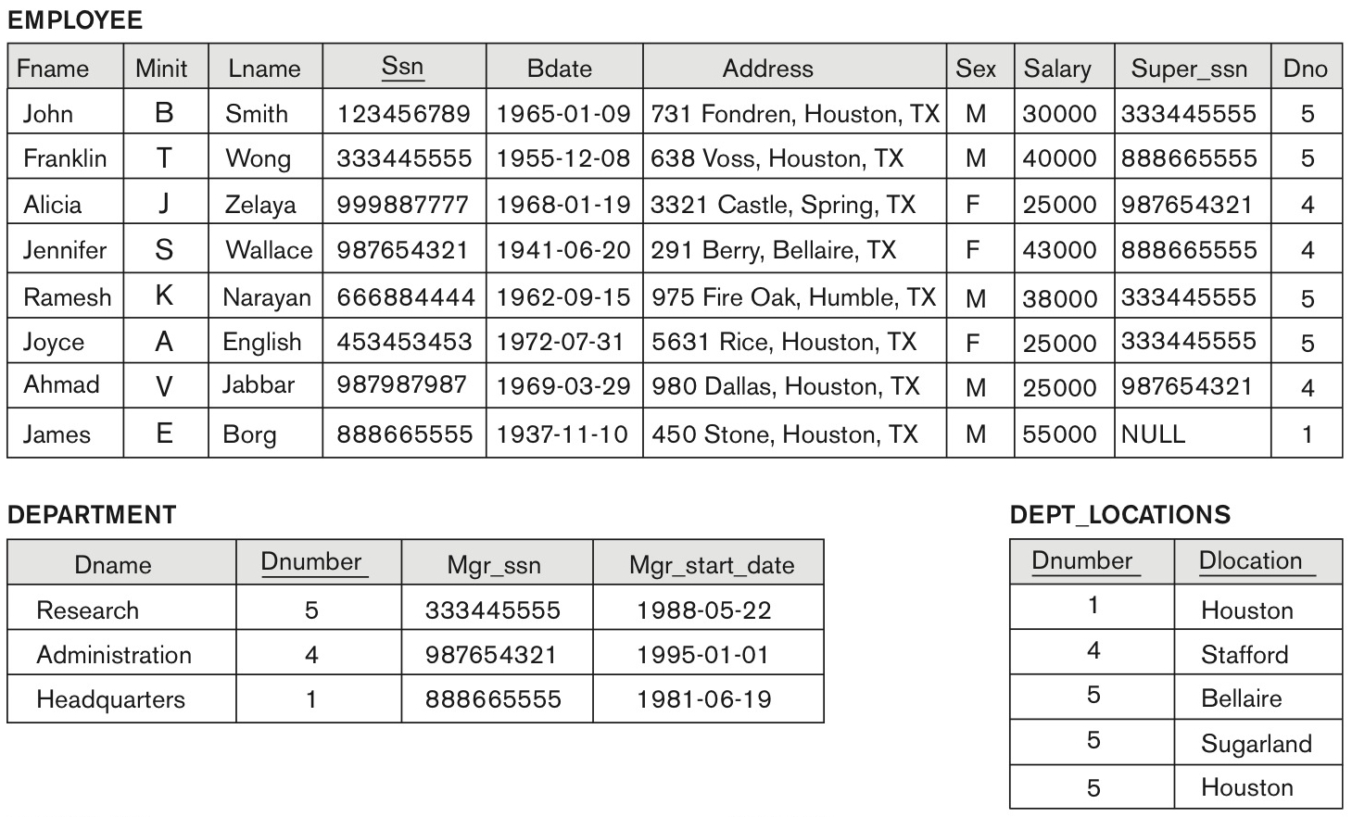
One possible database state for the COMPANY relational database schema (Fig. 5.6)
Slide 6- 12

Slide 13
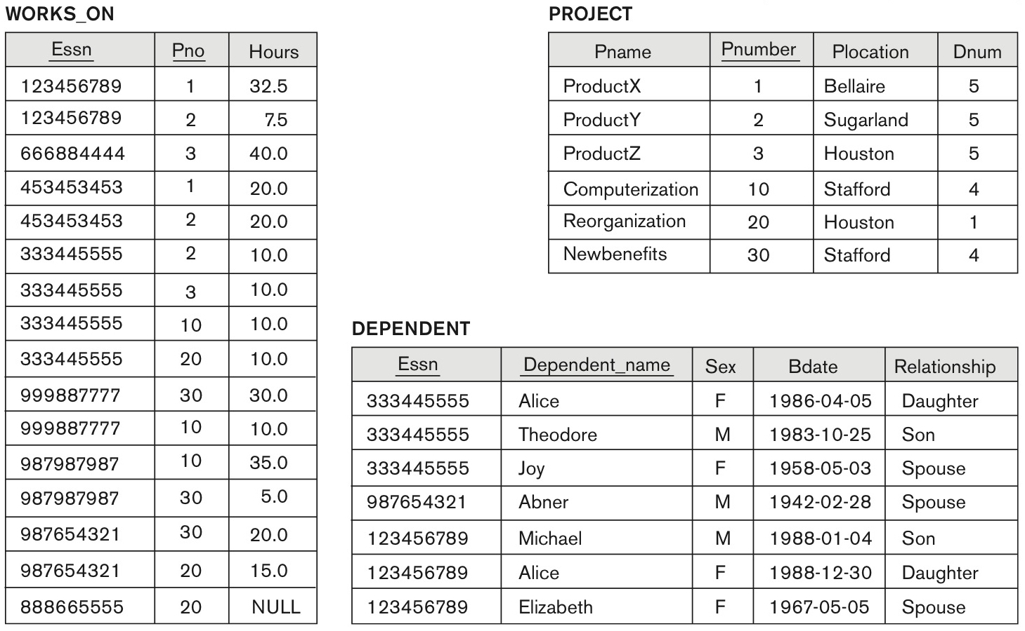
One possible database state for the COMPANY relational database schema – continued (Fig. 5.6)
Slide 6- 13

Slide 14
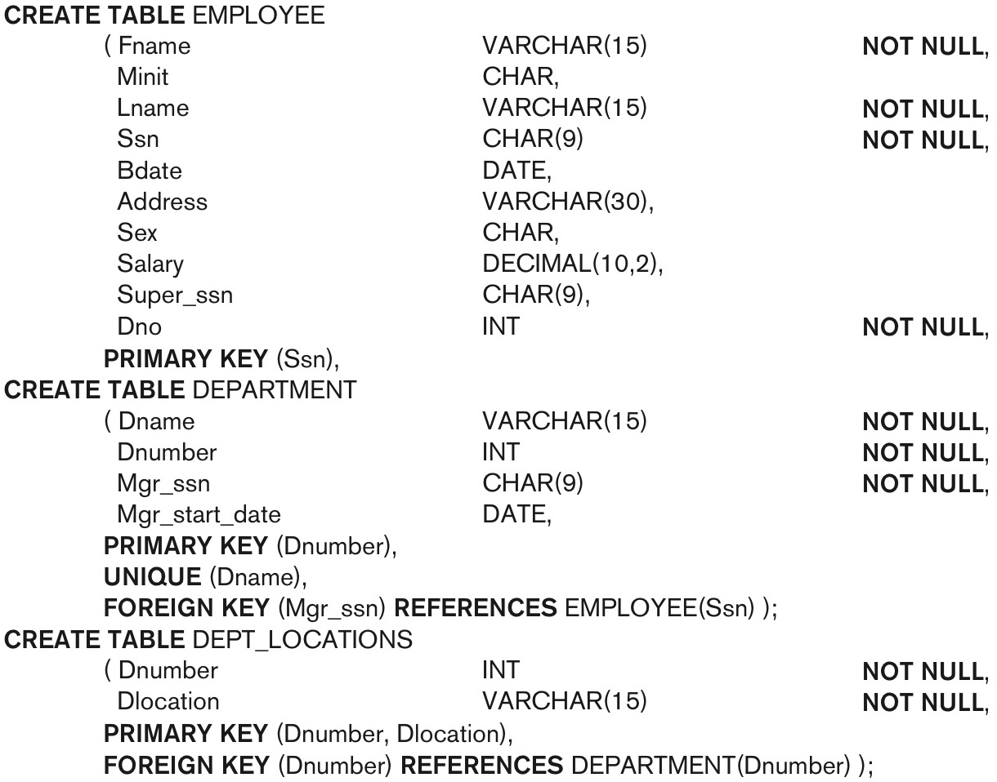
SQL CREATE TABLE data definition statements for defining the COMPANY schema from Figure 5.7 (Fig. 6.1)
continued on next slide
Slide 6- 14

Slide 15
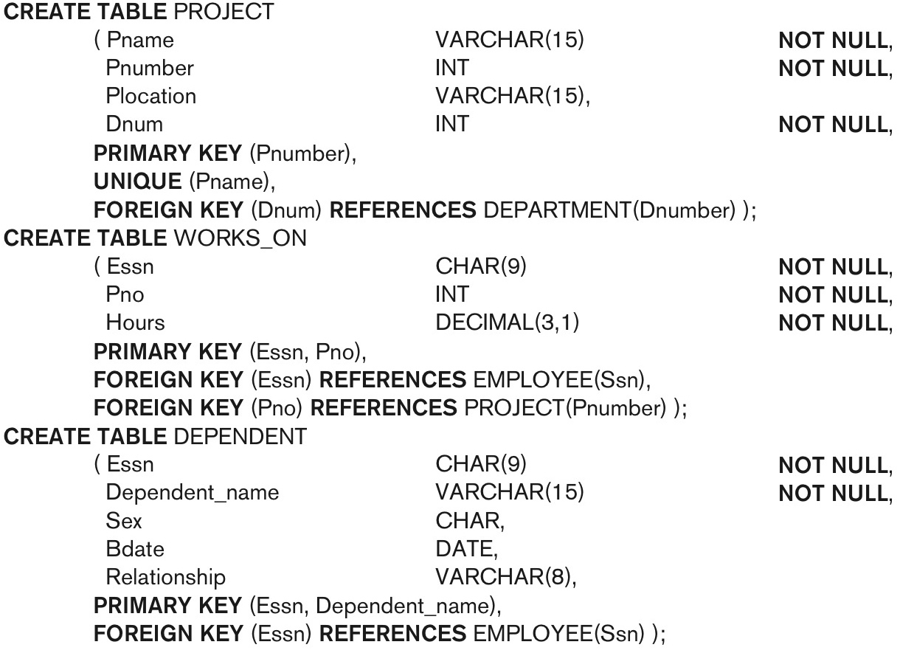
SQL CREATE TABLE data definition statements for defining the COMPANY schema from Figure 5.7 (Fig. 6.1)-continued
Slide 6- 15

Slide 16
INSERT, DELETE, and UPDATE Statements in SQL
Three commands used to modify the database:
  INSERT, DELETE, and UPDATE
INSERT typically inserts a tuple (row) in a relation (table)
UPDATE may update a number of tuples (rows) in a relation (table) that satisfy the condition
DELETE may also update a number of tuples (rows) in a relation (table) that satisfy the condition
Slide 6- 44

Slide 17
INSERT
In its simplest form, it is used to add one or more tuples to a relation
Attribute values should be listed in the same order as the attributes were specified in the CREATE TABLE command
Constraints on data types are observed automatically
Any integrity constraints as a part of the DDL specification are enforced
Slide 6- 45

Slide 18


The INSERT Command
Specify the relation name and a list of values for the tuple. All values including nulls are supplied.
The variation below inserts multiple tuples where a new table is loaded values from the result of a query.
Slide 6- 46

Slide 19
BULK LOADING OF TABLES
Another variation of INSERT is used for bulk-loading of several tuples into tables
A new table TNEW can be created with the same attributes as T and using LIKE and DATA in the syntax, it can be loaded with entire data.
EXAMPLE:
CREATE TABLE D5EMPS LIKE EMPLOYEE
(SELECT E.*
FROM EMPLOYEE AS E
WHERE E.Dno=5)
WITH DATA;
Slide 6- <number>

Slide 20
DELETE
Removes tuples from a relation
  Includes a WHERE-clause to select the tuples to be deleted
  Referential integrity should be enforced
  Tuples are deleted from only one table at a time (unless CASCADE is specified on a referential integrity constraint)
  A missing WHERE-clause specifies that all tuples in the relation are to be deleted; the table then becomes an empty table
  The number of tuples deleted depends on the number of tuples in the relation that satisfy the WHERE-clause
Slide 6- 48

Slide 21

The DELETE Command
Removes tuples from a relation
  Includes a WHERE clause to select the tuples to be deleted. The number of tuples deleted will vary.
Slide 6- 49

Slide 22
UPDATE
Used to modify attribute values of one or more selected tuples
A WHERE-clause selects the tuples to be modified
An additional SET-clause specifies the attributes to be modified and their new values
Each command modifies tuples in the same relation
Referential integrity specified as part of DDL specification is enforced
Slide 6- 50

Slide 23
UPDATE (contd.)
Example: Change the location and controlling department number of project number 10 to 'Bellaire' and 5, respectively
  U5: UPDATE PROJECT
  SET PLOCATION = 'Bellaire', DNUM = 5
  WHERE PNUMBER=10
Slide 6- 51

Slide 24
UPDATE (contd.)
Example: Give all employees in the 'Research' department a 10% raise in salary.
  U6: UPDATE EMPLOYEE
  SET SALARY = SALARY *1.1
  WHERE DNO IN (SELECT DNUMBER
  FROM DEPARTMENT
  WHERE DNAME='Research')
In this request, the modified SALARY value depends on the original SALARY value in each tuple
  The reference to the SALARY attribute on the right of = refers to the old SALARY value before modification
  The reference to the SALARY attribute on the left of = refers to the new SALARY value after modification
Slide 6- <number>

Slide 25
The CREATE TABLE Command in SQL (cont’d.)
Some foreign keys may cause errors
  Specified either via:
    Circular references
    Or because they refer to a table that has not yet been created
  DBA’s have ways to stop referential integrity enforcement to get around this problem.
Slide 6- 16

Slide 26
Attribute Data Types and Domains in SQL
Basic data types
  Numeric data types
    Integer numbers: INTEGER, INT, and SMALLINT
    Floating-point (real) numbers: FLOAT or REAL, and DOUBLE PRECISION
  Character-string data types
    Fixed length: CHAR(n), CHARACTER(n)
    Varying length: VARCHAR(n), CHAR VARYING(n), CHARACTER VARYING(n)
Slide 6- 17

Slide 27
Attribute Data Types and Domains in SQL (cont’d.)
  Bit-string data types
    Fixed length: BIT(n)
    Varying length: BIT VARYING(n)
  Boolean data type
    Values of TRUE or FALSE or NULL
  DATE data type
    Ten positions
    Components are YEAR, MONTH, and DAY in the form YYYY-MM-DD
    Multiple mapping functions available in RDBMSs to change date formats
Slide 6- 18

Slide 28
Attribute Data Types and Domains in SQL (cont’d.)
Additional data types
  Timestamp data type
  Includes the DATE and TIME fields
    Plus a minimum of six positions for decimal fractions of seconds
    Optional WITH TIME ZONE qualifier
  INTERVAL data type
    Specifies a relative value that can be used to increment or decrement an absolute value of a date, time, or timestamp
  DATE, TIME, Timestamp, INTERVAL data types can be cast or converted to string formats for comparison.
Slide 6- 19

Slide 29
Attribute Data Types and Domains in SQL (cont’d.)
Domain
  Name used with the attribute specification
  Makes it easier to change the data type for a domain that is used by numerous attributes
  Improves schema readability
  Example:
    CREATE DOMAIN SSN_TYPE AS CHAR(9);
TYPE
  User Defined Types (UDTs) are supported for object-oriented applications. (See Ch.12) Uses the command: CREATE TYPE
Slide 6- <number>

Slide 30
Specifying Constraints in SQL
Basic constraints:
Relational Model has 3 basic constraint types that are supported in SQL:
  Key constraint: A primary key value cannot be duplicated
  Entity Integrity Constraint: A primary key value cannot be null
  Referential integrity constraints : The “foreign key “ must have a value that is already present as a primary key, or may be null.
Slide 6- <number>

Slide 31
Specifying Attribute Constraints
  Other Restrictions on attribute domains:
Default value of an attribute
  DEFAULT <value>
  NULL is not permitted for a particular attribute (NOT NULL)
CHECK clause
  Dnumber INT NOT NULL CHECK (Dnumber > 0 AND Dnumber < 21);
Slide 6- 22

Slide 32
Specifying Key and Referential Integrity Constraints
PRIMARY KEY clause
  Specifies one or more attributes that make up the primary key of a relation
  Dnumber INT PRIMARY KEY;
UNIQUE clause
  Specifies alternate (secondary) keys (called CANDIDATE keys in the relational model).
  Dname VARCHAR(15) UNIQUE;
Slide 6- <number>

Slide 33
Specifying Key and Referential Integrity Constraints (cont’d.)
FOREIGN KEY clause
  Default operation: reject update on violation
  Attach referential triggered action clause
    Options include SET NULL, CASCADE, and SET DEFAULT
    Action taken by the DBMS for SET NULL or SET DEFAULT is the same for both ON DELETE and ON UPDATE
    CASCADE option suitable for “relationship” relations
Slide 6- <number>

Slide 34
Giving Names to Constraints
Using the Keyword CONSTRAINT
  Name a constraint
  Useful for later altering
Slide 6- <number>

Slide 35
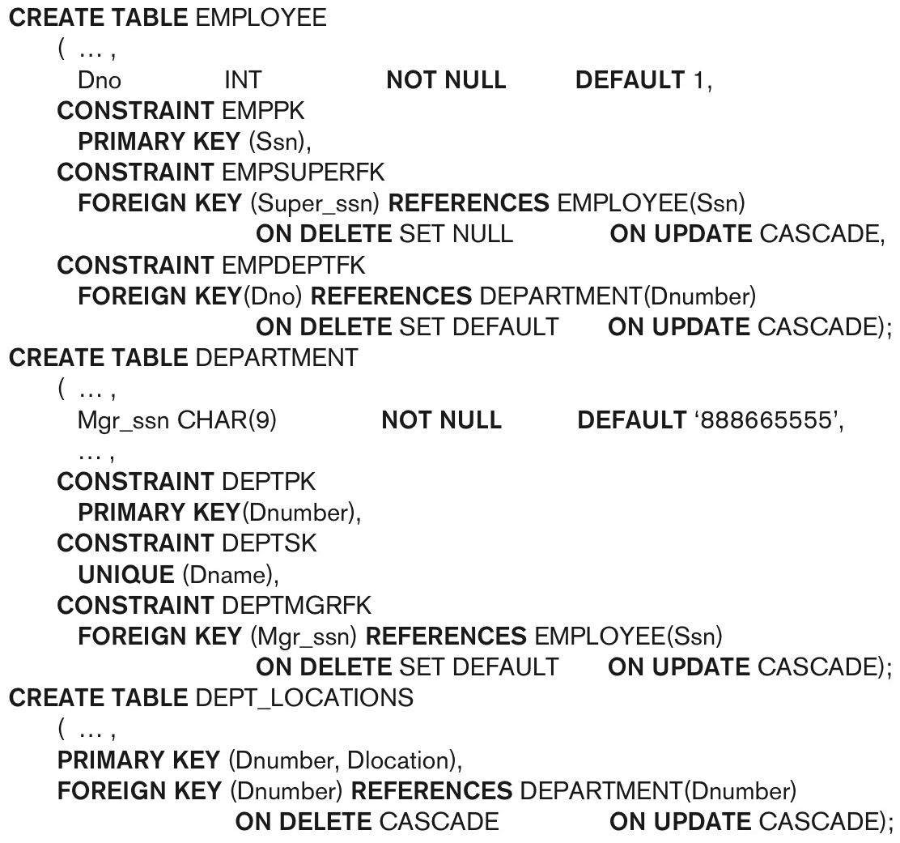
Default attribute values and referential integrity triggered action specification (Fig. 6.2)
Slide 6- <number>

Slide 36
Specifying Constraints on Tuples Using CHECK
  Additional Constraints on individual tuples within a relation are also possible using CHECK
CHECK clauses at the end of a CREATE TABLE statement
  Apply to each tuple individually
  CHECK (Dept_create_date <= Mgr_start_date);
Slide 6- <number>

Slide 37
Basic Retrieval Queries in SQL
SELECT statement
  One basic statement for retrieving information from a database
SQL allows a table to have two or more tuples that are identical in all their attribute values
  Unlike relational model (relational model is strictly set-theory based)
  Multiset or bag behavior
  Tuple-id may be used as a key
Slide 6- <number>

Slide 38

The SELECT-FROM-WHERE Structure of Basic SQL Queries
Basic form of the SELECT statement:
Slide 6- <number>

Slide 39
The SELECT-FROM-WHERE Structure of Basic SQL Queries (cont’d.)
Logical comparison operators
  =, <, <=, >, >=, and <>
Projection attributes
  Attributes whose values are to be retrieved
Selection condition
  Boolean condition that must be true for any retrieved tuple. Selection conditions include join conditions (see Ch.8) when multiple relations are involved.
Slide 6- 30

Slide 40
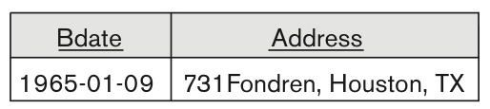
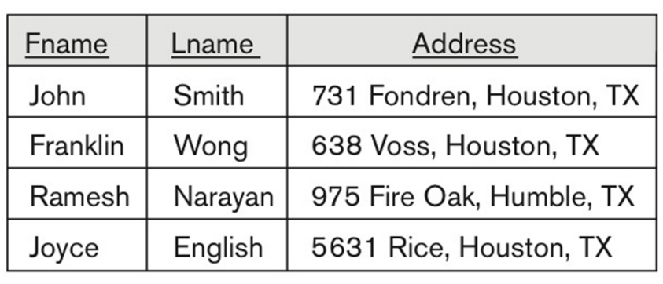


Basic Retrieval Queries
Slide 6- 31

Slide 41
One possible database state for the COMPANY relational database schema (Fig. 5.6)
Slide 6- 12

Slide 42
One possible database state for the COMPANY relational database schema – continued (Fig. 5.6)
Slide 6- 13

Slide 43


Basic Retrieval Queries (Contd.)
Slide 6- 32

Slide 44

Ambiguous Attribute Names
Same name can be used for two (or more) attributes in different relations
  As long as the attributes are in different relations
  Must qualify the attribute name with the relation name to prevent ambiguity
Slide 6- 33

Slide 45
Aliasing, and Renaming
Aliases or tuple variables
  Declare alternative relation names E and S to refer to the EMPLOYEE relation twice in a query:
Query 8. For each employee, retrieve the employee’s first and last name and the first and last name of his or her immediate supervisor.
SELECT E.Fname, E.Lname, S.Fname, S.Lname
FROM EMPLOYEE AS E, EMPLOYEE AS S
WHERE E.Super_ssn=S.Ssn;
  Recommended practice to abbreviate names and to prefix same or similar attribute from multiple tables.
Slide 6- 34

Slide 46
Aliasing,Renaming and Tuple Variables (contd.)
  The attribute names can also be renamed
  EMPLOYEE AS E(Fn, Mi, Ln, Ssn, Bd, Addr, Sex, Sal, Sssn, Dno)
  Note that the relation EMPLOYEE now has a variable name E which corresponds to a tuple variable
  The “AS” may be dropped in most SQL implementations
Slide 6- <number>

Slide 47

Unspecified WHERE Clause and Use of the Asterisk
Missing WHERE clause
  Indicates no condition on tuple selection
Effect is a CROSS PRODUCT
  Result is all possible tuple combinations (or the Algebra operation of Cartesian Product– see Ch.8) result
Slide 6- 36

Slide 48

Unspecified WHERE Clause and Use of the Asterisk (cont’d.)
Specify an asterisk (*)
  Retrieve all the attribute values of the selected tuples
  The * can be prefixed by the relation name; e.g., EMPLOYEE *
Slide 6- 37

Slide 49

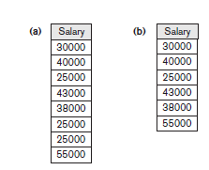
Tables as Sets in SQL
SQL does not automatically eliminate duplicate tuples in query results
For aggregate operations (See sec 7.1.7) duplicates must be accounted for
Use the keyword DISTINCT in the SELECT clause
  Only distinct tuples should remain in the result
Slide 6- 38

Slide 50

Tables as Sets in SQL (cont’d.)
Set operations
  UNION, EXCEPT (difference), INTERSECT
  Corresponding multiset operations: UNION ALL, EXCEPT ALL, INTERSECT ALL)
  Type compatibility is needed for these operations to be valid
Slide 6- 39

Slide 51
Substring Pattern Matching and Arithmetic Operators
LIKE comparison operator
  Used for string pattern matching
  % replaces an arbitrary number of zero or more characters
  underscore (_) replaces a single character
  Examples: WHERE Address LIKE ‘%Houston,TX%’;
  WHERE Ssn LIKE ‘_ _ 1_ _ 8901’;
BETWEEN comparison operator
E.g., in Q14 :
WHERE(Salary BETWEEN 30000 AND 40000)
AND Dno = 5;
Slide 6- 40

Slide 52
Arithmetic Operations
Standard arithmetic operators:
  Addition (+), subtraction (–), multiplication (*), and division (/) may be included as a part of SELECT
Query 13. Show the resulting salaries if every employee working on the ‘ProductX’ project is given a 10 percent raise.
  SELECT E.Fname, E.Lname, 1.1 * E.Salary AS Increased_sal
  FROM EMPLOYEE AS E, WORKS_ON AS W, PROJECT AS P
  WHERE E.Ssn=W.Essn AND W.Pno=P.Pnumber AND P.Pname=‘ProductX’;
Slide 6- <number>

Slide 53
Ordering of Query Results
Use ORDER BY clause
  Keyword DESC to see result in a descending order of values
  Keyword ASC to specify ascending order explicitly
  Typically placed at the end of the query
  ORDER BY D.Dname DESC, E.Lname ASC, E.Fname ASC
Slide 6- <number>

Slide 54

Basic SQL Retrieval Query Block
Slide 6- 43

Slide 55
Additional Features of SQL
Techniques for specifying complex retrieval queries (see Ch.7)
Writing programs in various programming languages that include SQL statements: Embedded and dynamic SQL, SQL/CLI (Call Level Interface) and its predecessor ODBC, SQL/PSM (Persistent Stored Module) (See Ch.10)
Set of commands for specifying physical database design parameters, file structures for relations, and access paths, e.g., CREATE INDEX
Slide 6- 53

Slide 56
Additional Features of SQL (cont’d.)
Transaction control commands (Ch.20)
Specifying the granting and revoking of privileges to users (Ch.30)
Constructs for creating triggers (Ch.26)
Enhanced relational systems known as object-relational define relations as classes. Abstract data types (called User Defined Types- UDTs) are supported with CREATE TYPE
New technologies such as XML (Ch.13) and OLAP (Ch.29) are added to versions of SQL
Slide 6- 54

Slide 57
Summary
SQL
  A Comprehensive language for relational database management
  Data definition, queries, updates, constraint specification, and view definition
Covered :
  Data definition commands for creating tables
  Commands for constraint specification
  Simple retrieval queries
  Database update commands
Slide 6- 55

